Slide 1


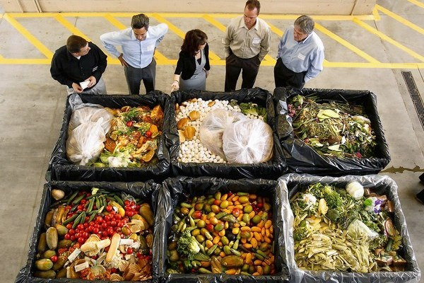
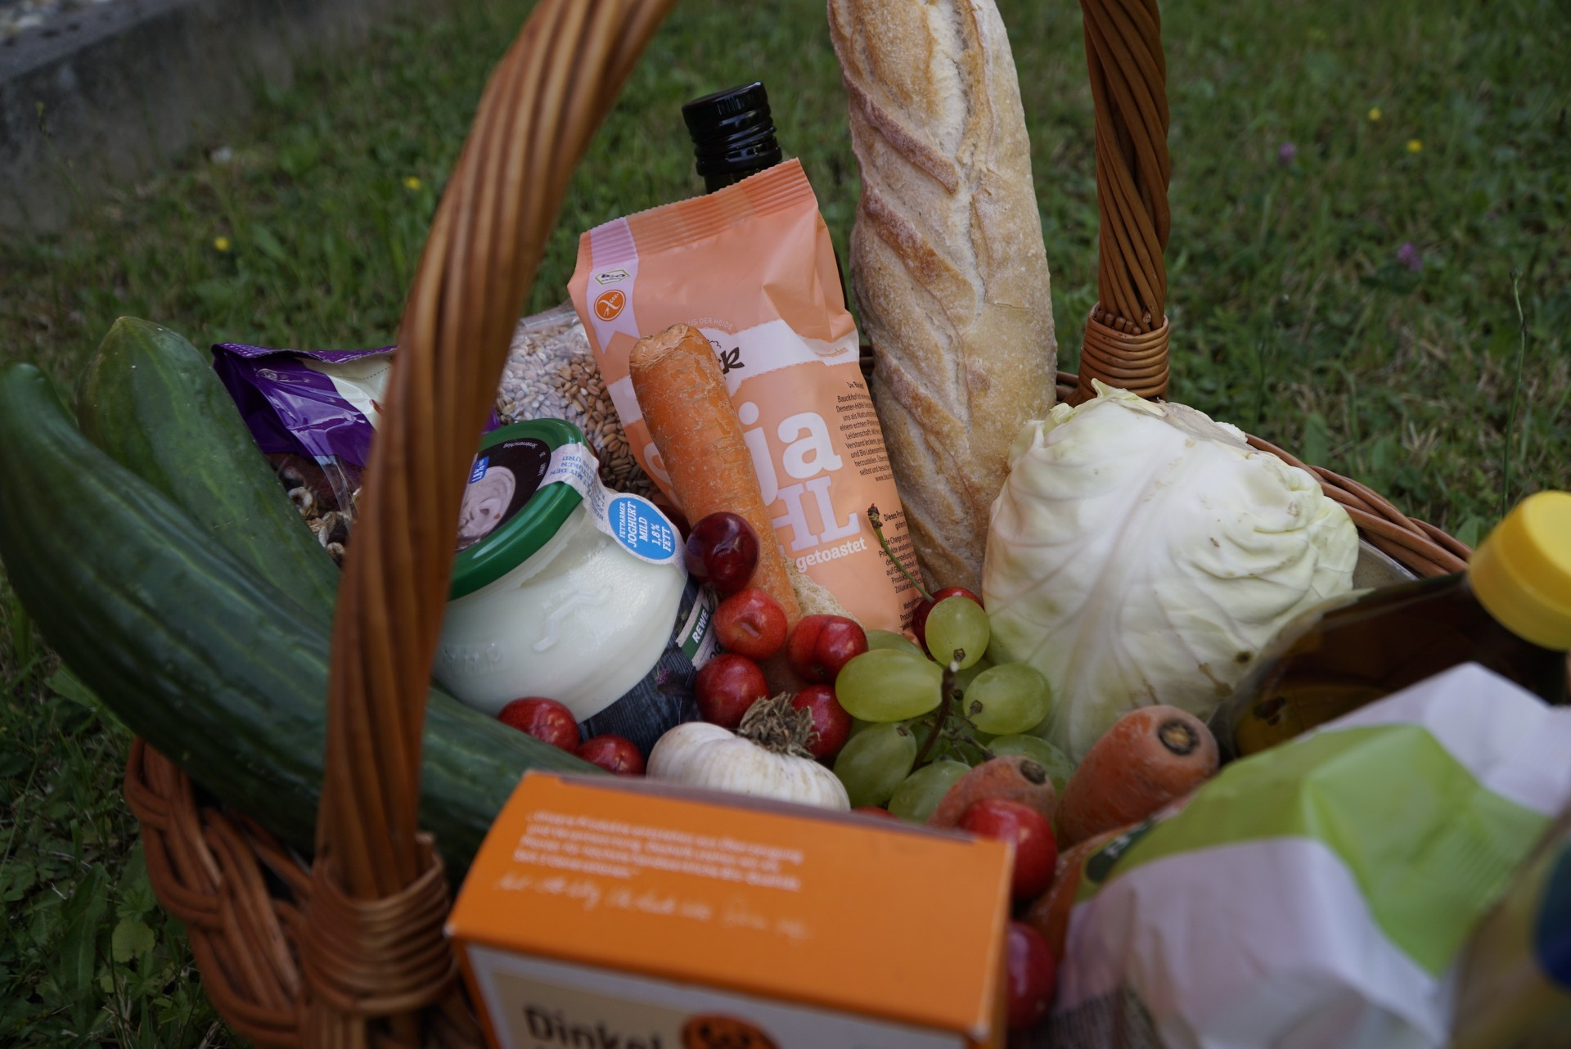



Tafel Paderborn e.V. Mission:
Tafel Paderborn is a non-profit organization dedicated to supporting people in need and fighting against food waste.
Activities: The organization collects surplus food from supermarkets, bakeries, restaurants, and other food businesses. They sort and distribute these food items to registered individuals and families facing economic hardship through weekly distribution centers.
Supporting Communities: Tafel Paderborn serves as a vital resource for individuals and families experiencing food insecurity in the Paderborn area. Food Rescue: The organization collects quality surplus food from local businesses, reducing food waste and diverting it to those in need.
Volunteer Engagement: Tafel Paderborn relies on the dedication of volunteers who contribute their time and efforts to ensure efficient food collection, sorting, and distribution to registered beneficiaries.
The European Commission's support for the production of this publication does not constitute an endorsement of the contents, which reflect the views only of the authors, and the Commission cannot be held responsible for any use which may be made of the information contained therein
2021-1-SK01-KA220-VET-000033080

