Slide 1

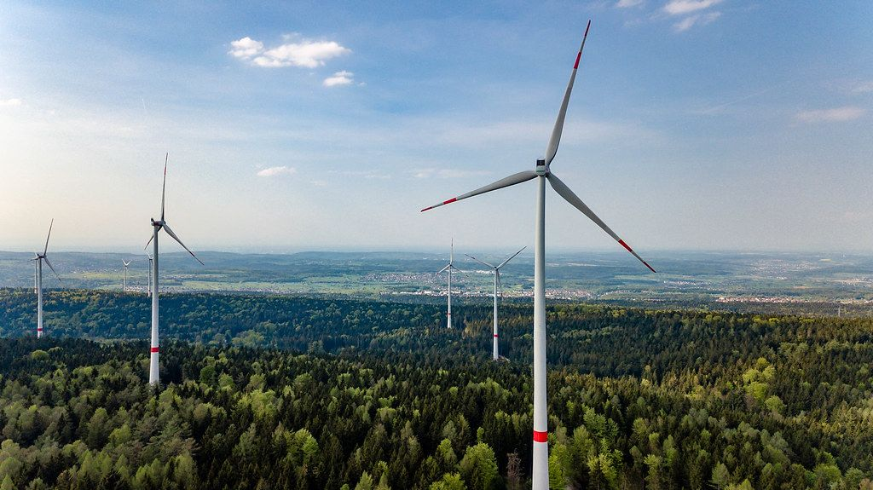



EcoTech Solutions
Our Mission:
EcoTech Solutions is committed to providing sustainable energy solutions to reduce carbon emissions and promote a greener future. Through innovative technologies and services, they aim to enable individuals and businesses to transition towards renewable energy sources and optimize energy efficiency
EcoTech Solutions specializes in developing and implementing cutting-edge technologies for renewable energy generation. Their solutions include solar panels, wind turbines, and energy storage systems, designed to harness clean and abundant sources of energy and reduce reliance on fossil fuels.
"Dieses Foto" von Unbekannter Autor ist lizenziert gemäß CC BY
The European Commission's support for the production of this publication does not constitute an endorsement of the contents, which reflect the views only of the authors, and the Commission cannot be held responsible for any use which may be made of the information contained therein
2021-1-SK01-KA220-VET-000033080

