Slide 1
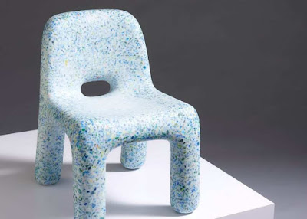




EcoBirdy –
Transforming Plastic Toys into Sustainable Furniture
Key Features: EcoBirdy collects and recycles plastic toys, processes them into high-quality recycled plastic, and designs and manufactures safe and durable children's furniture. The furniture is made from 100% recycled plastic and is fully recyclable at the end of its lifecycle.
EcoBirdy's sustainable furniture provides an opportunity for parents and caregivers to make environmentally responsible choices for their children. By choosing EcoBirdy products, they contribute to the reduction of plastic waste and teach children the importance of sustainability. The furniture's vibrant designs and functionality also inspire creativity and provide a safe and eco-friendly environment for children to grow and play.
"Dieses Foto" von Unbekannter Autor ist lizenziert gemäß CC BY-SA-NC
The European Commission's support for the production of this publication does not constitute an endorsement of the contents, which reflect the views only of the authors, and the Commission cannot be held responsible for any use which may be made of the information contained therein
2021-1-SK01-KA220-VET-000033080

