Slide 1



EcoBirdy –
Transforming Plastic Toys into Sustainable Furniture
"Dieses Foto" von Unbekannter Autor ist lizenziert gemäß CC BY-SA-NC
The European Commission's support for the production of this publication does not constitute an endorsement of the contents, which reflect the views only of the authors, and the Commission cannot be held responsible for any use which may be made of the information contained therein
2021-1-SK01-KA220-VET-000033080

Slide 2
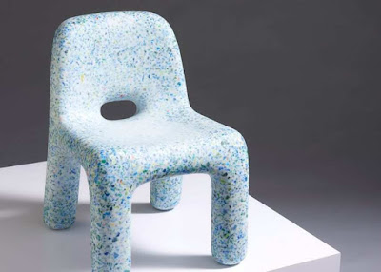
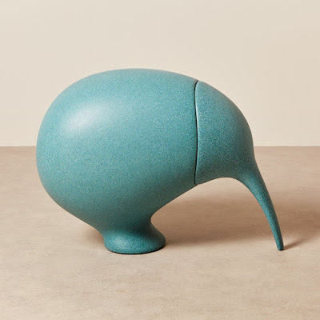
EcoBirdy –
Transforming Plastic Toys into Sustainable Furniture
Key Features: EcoBirdy collects and recycles plastic toys, processes them into high-quality recycled plastic, and designs and manufactures safe and durable children's furniture. The furniture is made from 100% recycled plastic and is fully recyclable at the end of its lifecycle.
EcoBirdy's sustainable furniture provides an opportunity for parents and caregivers to make environmentally responsible choices for their children. By choosing EcoBirdy products, they contribute to the reduction of plastic waste and teach children the importance of sustainability. The furniture's vibrant designs and functionality also inspire creativity and provide a safe and eco-friendly environment for children to grow and play.
"Dieses Foto" von Unbekannter Autor ist lizenziert gemäß CC BY-SA-NC
The European Commission's support for the production of this publication does not constitute an endorsement of the contents, which reflect the views only of the authors, and the Commission cannot be held responsible for any use which may be made of the information contained therein
2021-1-SK01-KA220-VET-000033080

Slide 3
EcoBirdy –
Transforming Plastic Toys into Sustainable Furniture
Background:
Plastic waste has become a global environmental challenge, particularly in the context of children's toys.
Recognizing the need for a sustainable solution, EcoBirdy was founded with the mission to transform plastic
waste into high-quality furniture that aligns with ecological and safety standards.
"Dieses Foto" von Unbekannter Autor ist lizenziert gemäß CC BY-SA-NC
The European Commission's support for the production of this publication does not constitute an endorsement of the contents, which reflect the views only of the authors, and the Commission cannot be held responsible for any use which may be made of the information contained therein
2021-1-SK01-KA220-VET-000033080

Slide 4
EcoBirdy –
Transforming Plastic Toys into Sustainable Furniture
Challenges:
Plastic Toy Waste: The abundance of plastic toys discarded by children poses an
environmental threat due to their non-biodegradable nature and potential for ending
up in landfills or oceans.
.
Safe and Sustainable Design: Creating furniture that is not only aesthetically
pleasing and functional but also safe for children requires careful consideration
of material selection and manufacturing processes.
"Dieses Foto" von Unbekannter Autor ist lizenziert gemäß CC BY-SA-NC
The European Commission's support for the production of this publication does not constitute an endorsement of the contents, which reflect the views only of the authors, and the Commission cannot be held responsible for any use which may be made of the information contained therein
2021-1-SK01-KA220-VET-000033080

Slide 5
EcoBirdy –
Transforming Plastic Toys into Sustainable Furniture
Background:
Plastic waste has become a global environmental challenge, particularly in the context of children's toys.
Recognizing the need for a sustainable solution, EcoBirdy was founded with the mission to transform plastic
waste into high-quality furniture that aligns with ecological and safety standards.
"Dieses Foto" von Unbekannter Autor ist lizenziert gemäß CC BY-SA-NC
The European Commission's support for the production of this publication does not constitute an endorsement of the contents, which reflect the views only of the authors, and the Commission cannot be held responsible for any use which may be made of the information contained therein
2021-1-SK01-KA220-VET-000033080

Slide 6
EcoBirdy –
Transforming Plastic Toys into Sustainable Furniture
Approach:
Toy Collection and Recycling: EcoBirdy collects plastic toys through partnerships with recycling
centers, schools, and community initiatives. These toys undergo a rigorous recycling process to ensure
the highest quality of recycled plastic material.
"Dieses Foto" von Unbekannter Autor ist lizenziert gemäß CC BY-SA-NC
The European Commission's support for the production of this publication does not constitute an endorsement of the contents, which reflect the views only of the authors, and the Commission cannot be held responsible for any use which may be made of the information contained therein
2021-1-SK01-KA220-VET-000033080

Slide 7
EcoBirdy –
Transforming Plastic Toys into Sustainable Furniture
Material Transformation:
The collected toys are cleaned, sorted, and transformed into a unique plastic material suitable for
furniture production.
"Dieses Foto" von Unbekannter Autor ist lizenziert gemäß CC BY-SA-NC
The European Commission's support for the production of this publication does not constitute an endorsement of the contents, which reflect the views only of the authors, and the Commission cannot be held responsible for any use which may be made of the information contained therein
2021-1-SK01-KA220-VET-000033080

Slide 8
EcoBirdy –
Transforming Plastic Toys into Sustainable Furniture
Sustainable Design and Manufacturing:
EcoBirdy collaborates with renowned designers to create innovative and child-friendly furniture
designs. Their manufacturing process emphasizes resource efficiency, utilizing recycled plastic material
and minimizing waste generation
"Dieses Foto" von Unbekannter Autor ist lizenziert gemäß CC BY-SA-NC
The European Commission's support for the production of this publication does not constitute an endorsement of the contents, which reflect the views only of the authors, and the Commission cannot be held responsible for any use which may be made of the information contained therein
2021-1-SK01-KA220-VET-000033080

Slide 9
EcoBirdy –
Transforming Plastic Toys into Sustainable Furniture
Sustainable Product Line: EcoBirdy has successfully launched a range of children's furniture, including
chairs, tables, and storage units. Each piece is made entirely from recycled plastic, offering a sustainable
and eco-friendly alternative to traditional furniture.
Circular Economy Impact: By repurposing plastic toys into furniture, EcoBirdy has diverted a
significant amount of plastic waste from landfills and incineration, contributing to the circular economy
and reducing the environmental impact of discarded toys.
Safety and Compliance: EcoBirdy's furniture meets strict safety standards, ensuring that children can play and
interact with the furniture without exposure to harmful substances or risks.
The European Commission's support for the production of this publication does not constitute an endorsement of the contents, which reflect the views only of the authors, and the Commission cannot be held responsible for any use which may be made of the information contained therein
2021-1-SK01-KA220-VET-000033080

Slide 10
EcoBirdy –
Transforming Plastic Toys into Sustainable Furniture
Sustainable Design and Manufacturing:
EcoBirdy collaborates with renowned designers to create innovative and child-friendly furniture
designs. Their manufacturing process emphasizes resource efficiency, utilizing recycled plastic material
and minimizing waste generation
"Dieses Foto" von Unbekannter Autor ist lizenziert gemäß CC BY-SA-NC
The European Commission's support for the production of this publication does not constitute an endorsement of the contents, which reflect the views only of the authors, and the Commission cannot be held responsible for any use which may be made of the information contained therein
2021-1-SK01-KA220-VET-000033080

Slide 11
EcoBirdy –
Transforming Plastic Toys into Sustainable Furniture
Conclusion:
EcoBirdy's innovative approach to transforming plastic toys into sustainable children's furniture demonstrates the
possibilities of circular economy principles and sustainable design. By addressing the plastic waste issue while
creating safe and stylish products, EcoBirdy sets an example for green enterprises worldwide, highlighting the
potential for environmental stewardship and economic viability in the pursuit of sustainability.
"Dieses Foto" von Unbekannter Autor ist lizenziert gemäß CC BY-SA-NC
The European Commission's support for the production of this publication does not constitute an endorsement of the contents, which reflect the views only of the authors, and the Commission cannot be held responsible for any use which may be made of the information contained therein
2021-1-SK01-KA220-VET-000033080

